Slide 1

Using E-CRM for a unified view of the customer
COMMUNICATIONS OF THE ACM, April 2003, Vol.46 No.4
Shan L. Pan & Jae-Nam Lee
Reporter: Shing-Jiun Tsai

Slide 2

outline
Introduction
The emergence of e-CRM
Key applications of e-CRM
Management steps for e-CRM integration
Conclusions

Slide 3
Introduction
The emergence of e-commerce has changed many aspects of existing businesses.
Companies need the ability to track and manage Internet-based e-commerce events.
Companies have to maintain consistency across all interaction channels and across all areas of a company a customer interacts with.

Slide 4
Introduction
Many organizations are considering adopting the concept of electronic Customer Relationship Management (e-CRM).
E-CRM provides the ability to capture, integrate, and distribute data gained at the organization’s Web site throughout the enterprise.
Our goal is to provide useful guidelines for the efficient integration of e-CRM.

Slide 5
The emergence of e-CRM
e-CRM expands the traditional CRM techniques by integrating technologies of new electronic channels.
e-CRM solution supports marketing, sales and service.
With the advancement of Web-based technology, market dynamics are driving companies to adopt e-CRM.

Slide 6
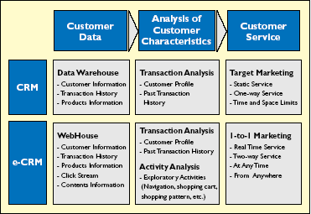
The differences between CRM and e-CRM

Slide 7
Key applications of e-CRM
A successful e-CRM solution is the challenge of consolidating all customer-related information into a single view.
e-CRM can enable companies of all sizes and across all industries to offer one-to-one relationships to customers.
The conceptual relationship among five key e-CRM applications.

Slide 8
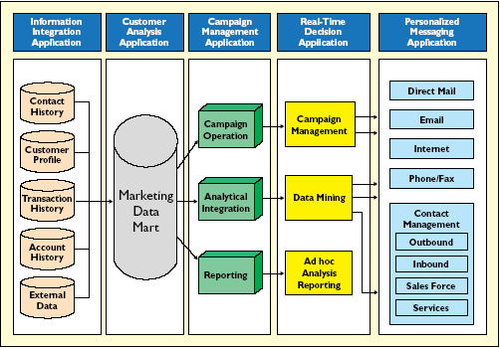

Slide 9
Key applications of e-CRM
Information integration application
  an incomplete view of customers reduces their loyalty and trust
  consolidating customer data and information from different sources
  to keep up with every customer’s interaction

Slide 10
Key applications of e-CRM
Customer analysis application
  measures, predicts, and interprets customer behaviors
  predictive models to identify the customers most likely to perform a particular activity
  online analytical processing, data mining and statistics

Slide 11
Key applications of e-CRM
Campaign management application
  integration of multichannel communications with individual customers
  using the data warehouse to plan and execute
  campaign operation, analytical integration, reporting

Slide 12
Key applications of e-CRM
Real-time decision application
  to coordinate and synchronize communications across disparate customer
  an effective real-time decision application promotes information exchange between the company and every customer

Slide 13
Key applications of e-CRM
Personalized messaging application
  building customer profiles and enables customized product and service offerings based on the information integration application

Slide 14
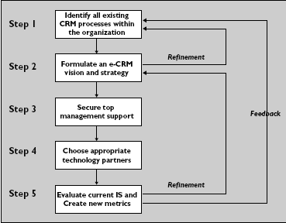
Management steps for e-CRM integration

Slide 15
Management steps for e-CRM integration
Identify all existing CRM processes within the organization
  It is crucial that the implementing organization takes a customer’s view rather than a marketer’s perspective.
Formulate an e-CRM vision and strategy
  A well-articulated strategy provides unequivocal direction to employees selecting and deploying e-CRM applications.
Secure top management support
  Top management can act as a project sponsor as well as a project champion in the implementation process of e-CRM.

Slide 16
Management steps for e-CRM integration
Choose appropriate technology partners
  To match the business processes and overall e-CRM vision of the organization.
Evaluate current IS and create new metrics
  Not only to speed adoption and increase overall return on investment, but also to check the performance of the customer relationship management and improve it.

Slide 17
conclusions
e-CRM application is actually integration with other points of contact, leading to a single view of the multichannel interactions.
Web-based CRM applications provide integrated marketing, sales…
A major consideration in deciding which e-CRM system to adopt depends largely on the compatibility of the system.

Slide 18
Thanks for your attention!!

